Slide 1
Temperature measurement using Thermal camera
By:
1. KOUSIGA A S
2. MOHANA T
3. BLESSY ESTHER S

Slide 2
Objective
To Measure the human body temperature using Thermal Camera.

Slide 3
Introduction
Thermal imaging is the process of converting infrared (IR) radiation (heat) into visible images that depict the spatial distribution of temperature differences in a scene viewed by a thermal camera. (temperature of an object)
A thermal image (thermogram) is a digital representation of a scene and a measure of the thermal radiation emitted by the pictured objects..

Slide 4
Components required:
Arduino Uno
AMG8833 8x8 IR GRIDEYE
128x128 TFT LCD Module
Breadboard
Jumper Wires

Slide 5
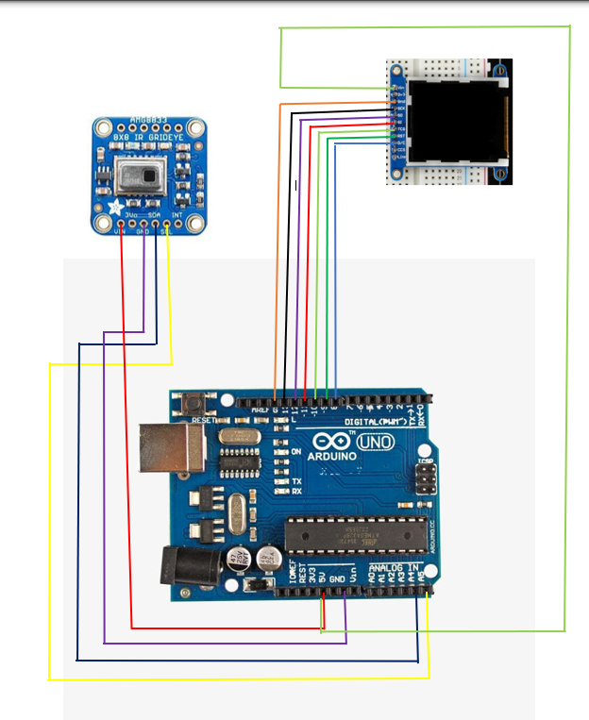
Block diagram:

Slide 6
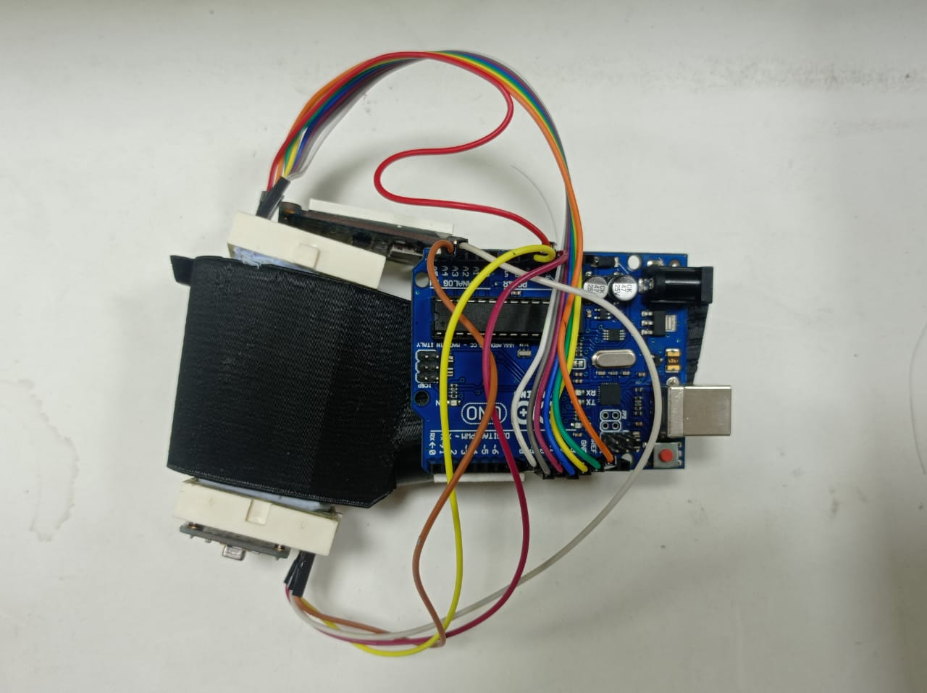
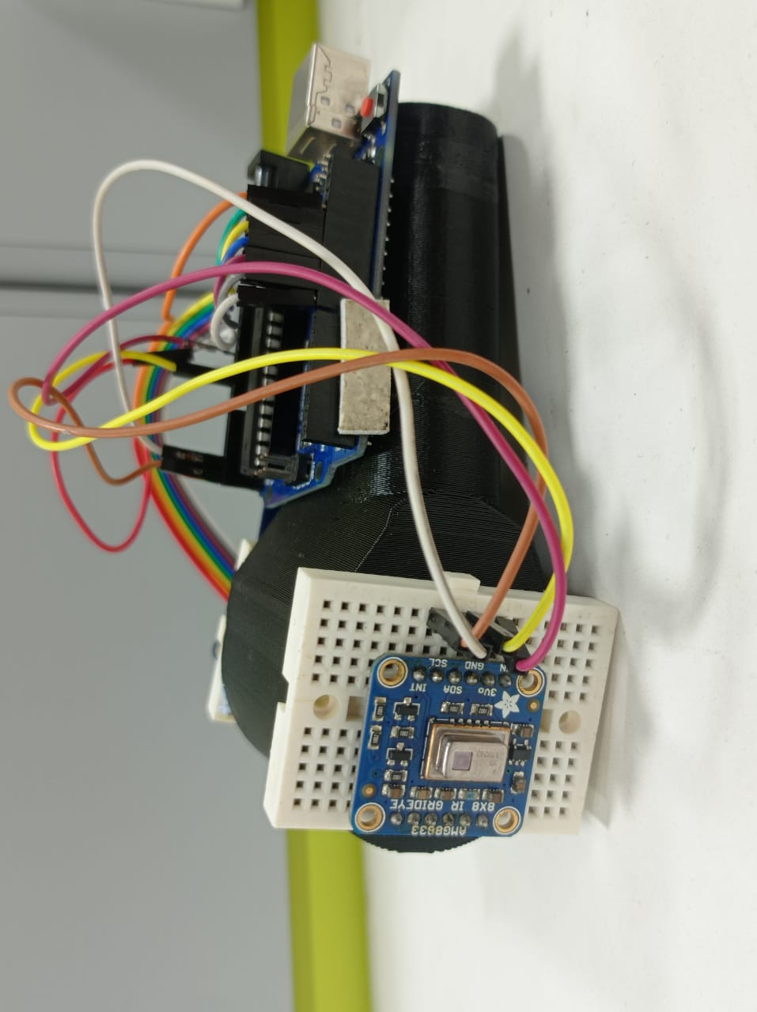
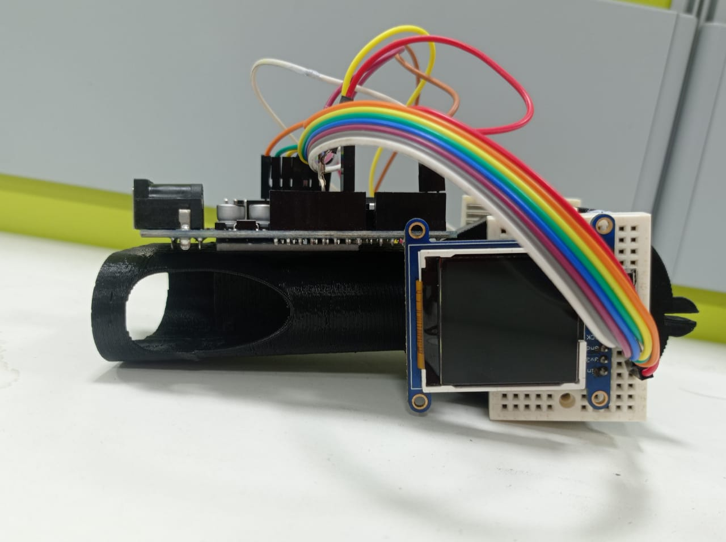
Circuit setup:

Slide 7
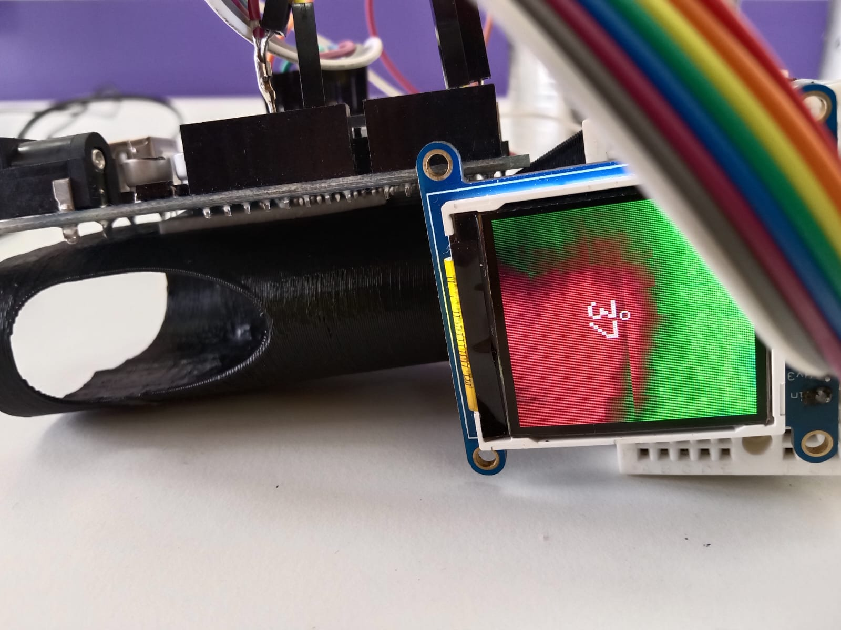
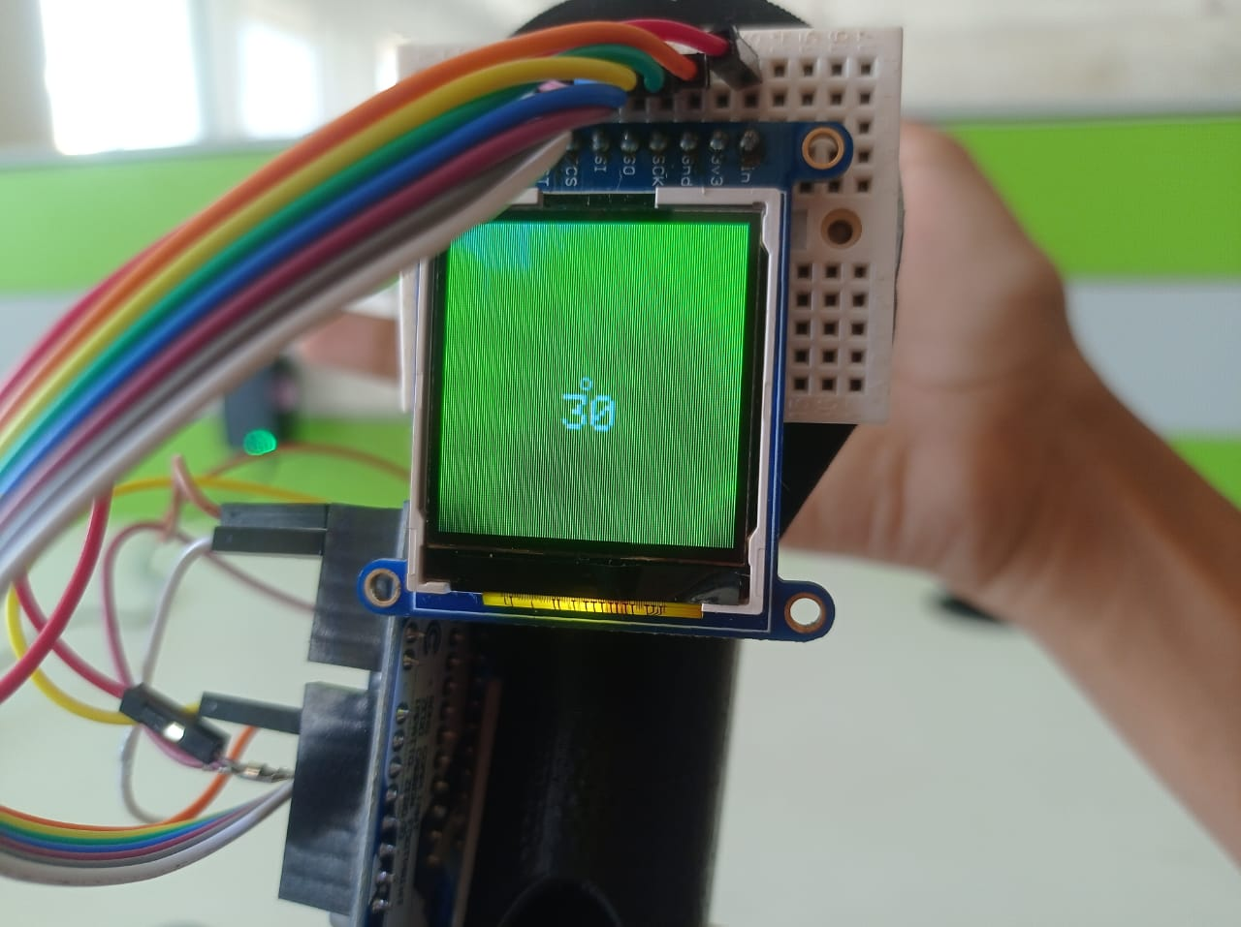
Output:
Measuring body temperature:
Measuring hot water temperature:

Slide 8
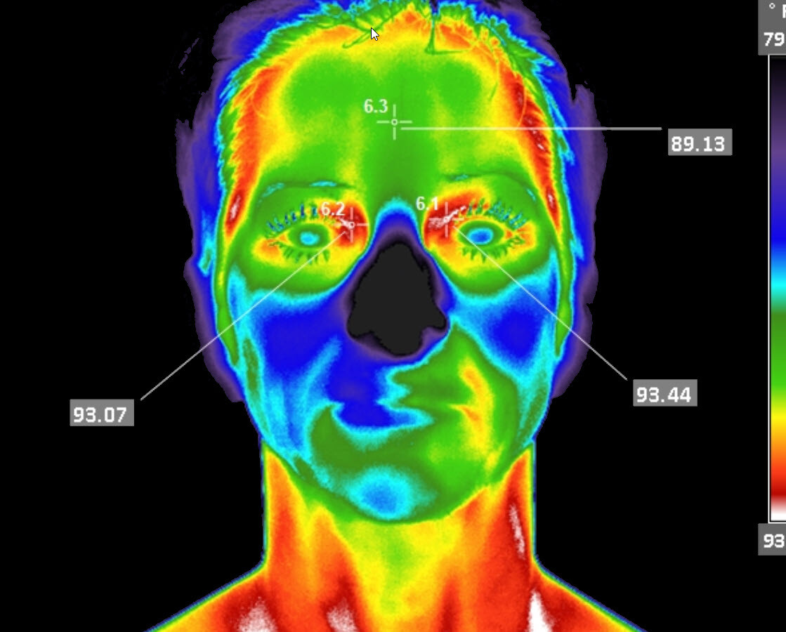
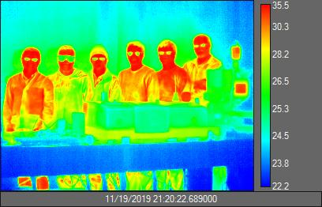
Output from thermal camera:

Slide 9
Future scope :
Detecting living and non living things.
Detecting coolest and hottest places.
Thermal imaging technology.

Slide 10
Application:
Electrical Wiring maintenance
Checking 3-phase equipment
First responders
Security
Animal Health
Mechanical Installations
Gas Detection

Slide 11
Conclusion
From this project, we obtained the appropriate temperature of objects including human body.

